Slide 1

Security Controls in Shared Source Code Repositories
Module 11.2 Assignment: Security Controls in Shared Source Code Repositories
Alejandro Quezada

Slide 2
Who can do what?
It is important to follow the principle of least privilege. It means that you only give enough permission to someone to be able to do their job. If everyone has access to it regardless of their position and they get compromised, the malicious person can mess up the repository.

Slide 3

Backups, Backups, Backups
It is important to have more than one backup of the repository. If it somehow gets deleted, or a catastrophic event occurs we need a way to recover it. When it comes to backups it is best to have one off site and on site.

Slide 4
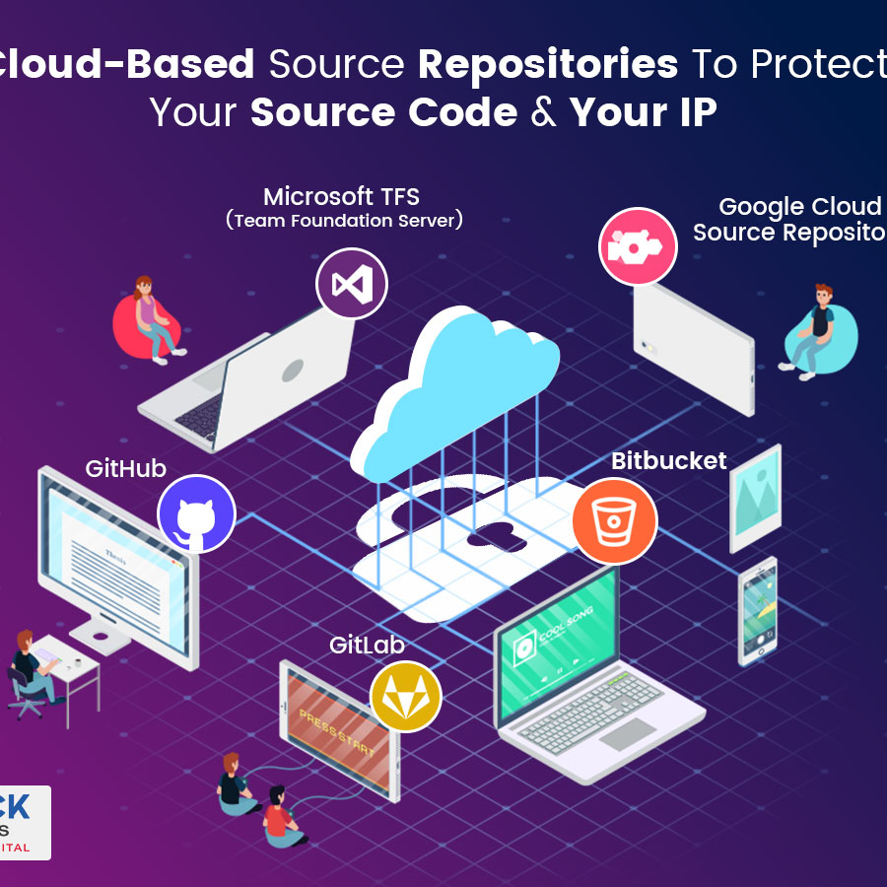
Research where the repository will be held
Look into how each of them could protect your repository. Also cryptographically sign it to further protect it.

Slide 5
Actively Manage Permissions
There are two reasons why this needs to be done.
As soon as you are aware that someone is no longer working there, all their permissions need to be revoked. This is especially true for access to critical data like a repository.
Other than that reason, you will revoke access if they no longer need it.

Slide 6
Review before the merge
Implement a process that will check code before merging. By doing so, you would prevent any malicious code from being merged as well. It is better to take the time to review than having to fix a mess.

Slide 7
Multi factor authorization
As inconvenient as it is to some it is crucial to implement 2FA wherever possible. You do not want anyone to gain access to your accounts and this is a great first step to do so. If a malicious person were to get your password, they can't do anything as 2FA is active.

Slide 8
In the event that it was breached
Isolate it as soon as possible, so you can then check into what files were manipulated. Inform to those relevant and then apply any updates to fix the problem. Double check the permissions and make any changes if needed. Also make changes to the incident response plan if things should've been done differently.

Slide 9
Check for any documentation
On github they provide a guide on how to secure a repository. After deciding on where to have your repository, first check to see if they provide a document on securing it. https://docs.github.com/en/code-security/getting-started/quickstart-for-securing-your-repository Even if others don't provide one, it doesn't hurt to follow some of the things mentioned from github.

Slide 10
Sources
Github document https://docs.github.com/en/code-security/getting-started/quickstart-for-securing-your-repository
Claudia Fernandes (18 Mar 2024) Source Code Security Best Practices: A Complete Guide assembla https://get.assembla.com/blog/source-code-security/
(n.d.) Secure development and deployment guidance National Cyber Security Centre https://www.ncsc.gov.uk/collection/developers-collection/principles/protect-your-code-repository
Chris Brook (2 May 2024) Source Code Security Best Practices to Protect Against Theft digitalguardian https://www.digitalguardian.com/blog/source-code-security-best-practices-protect-against-theft

